Slide 1

Template Design Masterclass for Fund Marketers


Slide 2
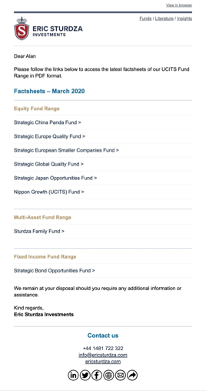
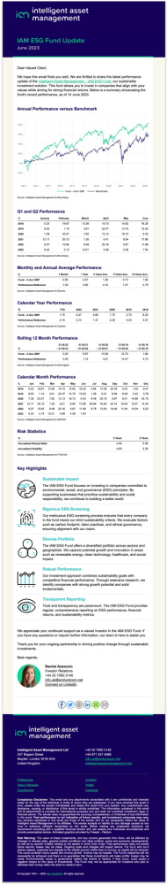

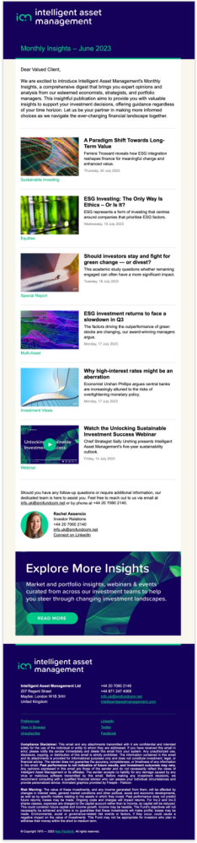
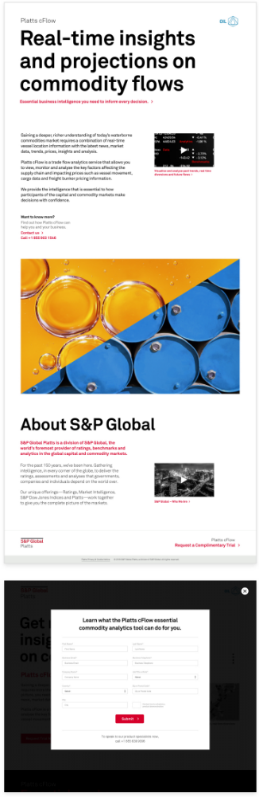
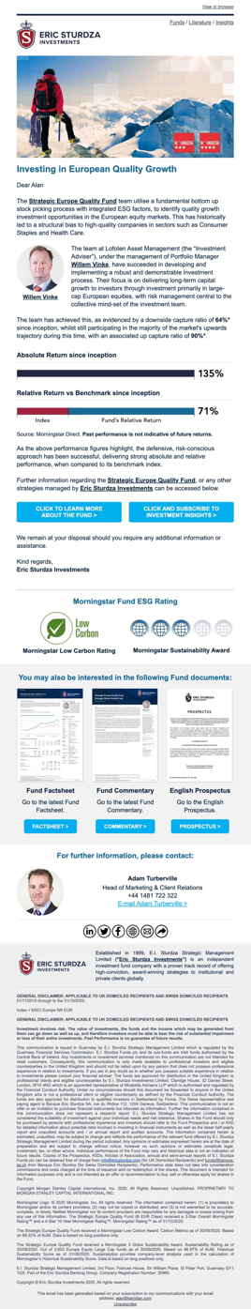
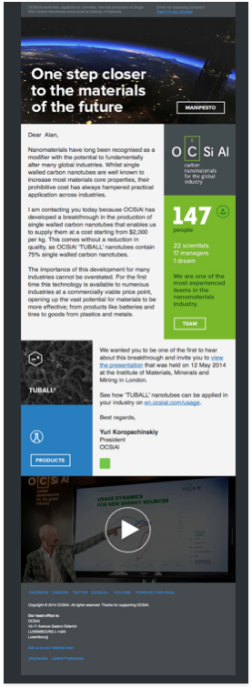
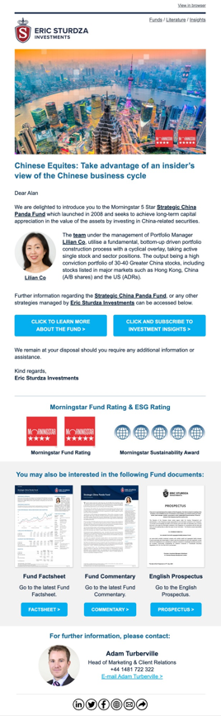

Template Masterclass

Slide 3
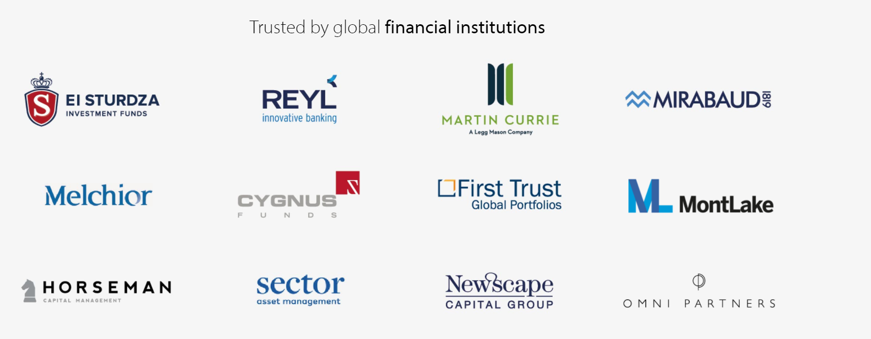


ProFundCom
Using Marketing Automation to Raise AuM
For the last 20 years we have helped fund managers raise assets using marketing automation

Slide 4

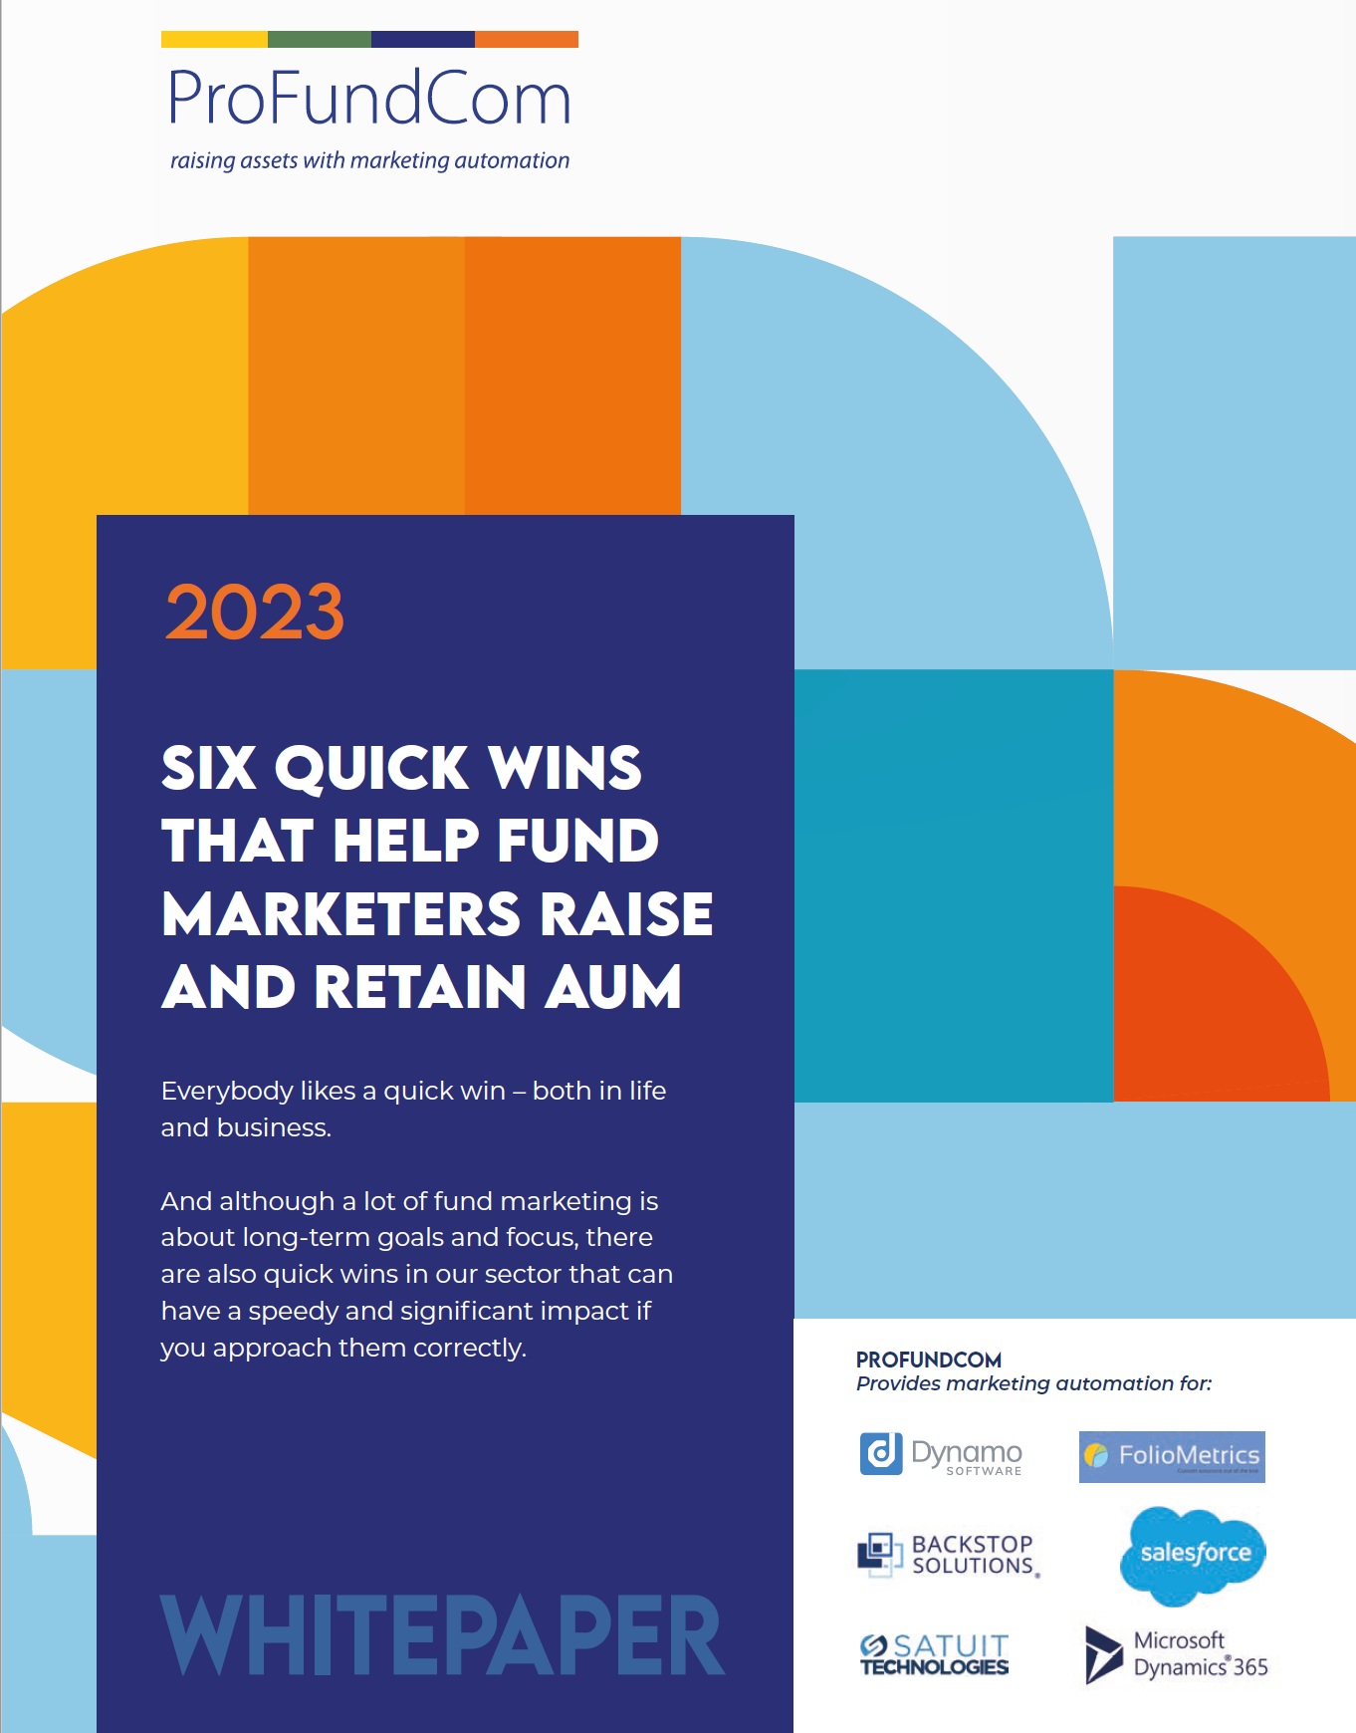
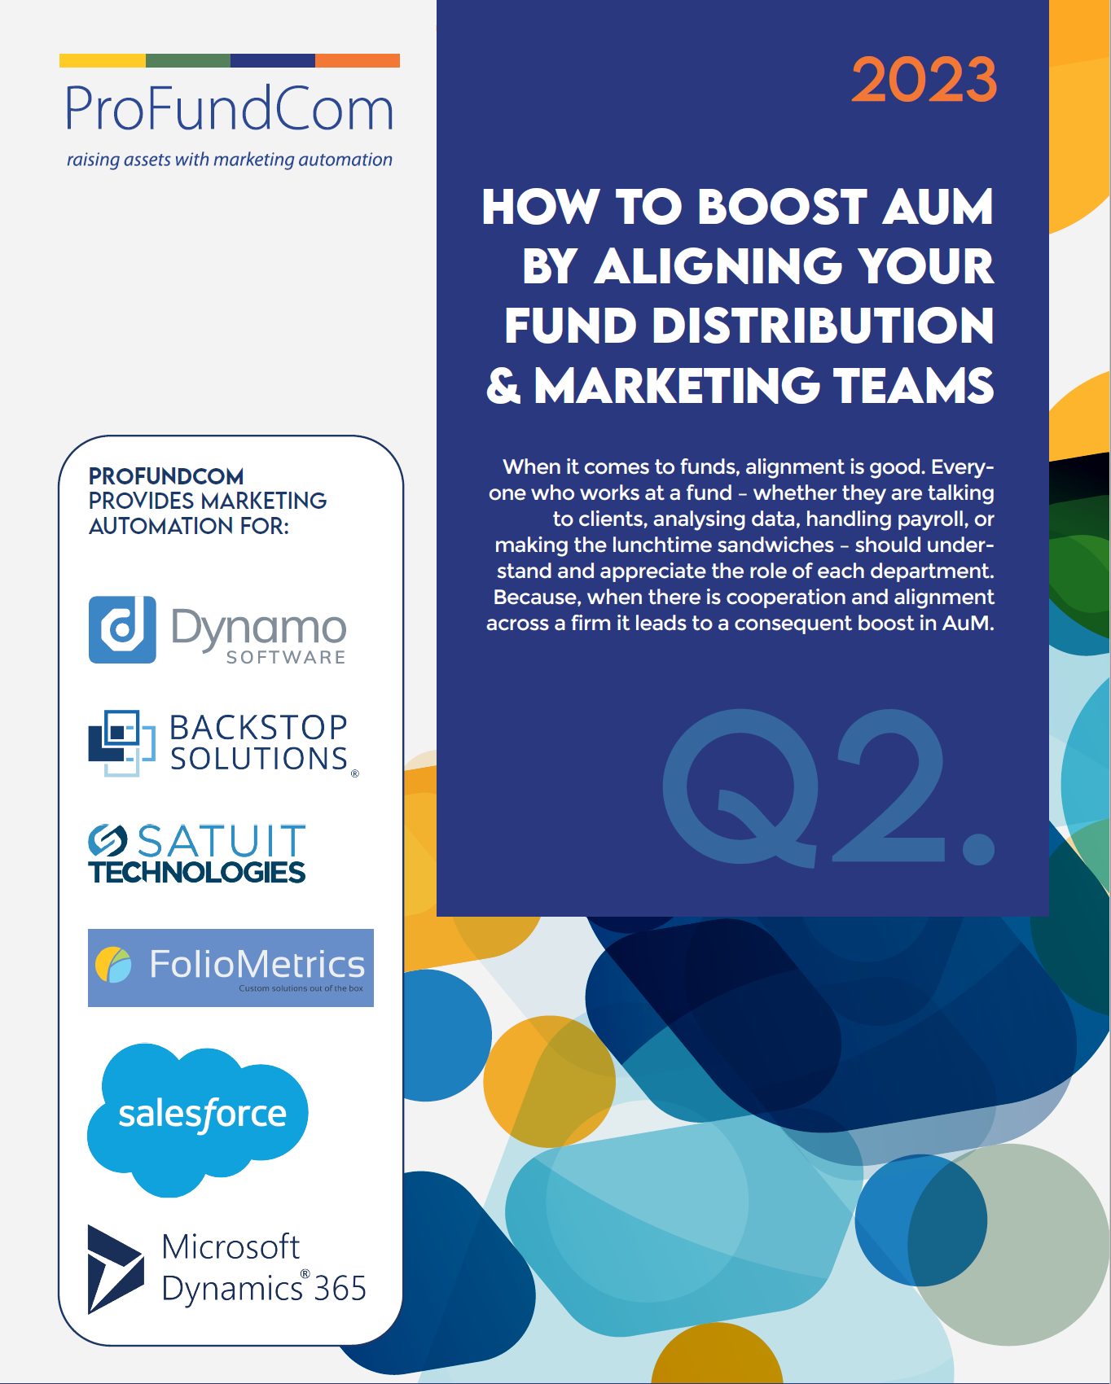
ProFundCom
Using Marketing Automation to Raise AuM
For the last 20 years we have helped fund managers raise assets using marketing automation

Slide 5
GTM – Go To Market
The REAL Plan – IF YOU ONLY DO ONE THING
INVESTMENT
1
2
3
4
5
BRAND
AWARENESS
DEMAND
GENERATION
NARRATIVE
ENGAGEMENT
ANALYTICS
The what you do and the why you do it
Creating content about the narrative for your Ideal Investor
Creating channels for the Ideal Investor to Engage with your Narrative and Brand
(Outbound)
Creating a demand for your Ideal Investors and they Engage with you
(Inbound)
Track engagement and target the right Ideal Investor at the right time
START

Slide 6
AGTM – Automated Go To Market
Create A Marketing Echo Chamber
INVESTMENT
1
2
3
4
5
BRAND
AWARENESS
NARRATIVE
DEMAND
ENGAGEMENT
ANALYTICS
The what you do and the why you do it
Creating content about the narrative for your Ideal Investor
Creating channels for the Ideal Investor to Engage with your Narrative and Brand
(Outbound)
Creating a demand for your Ideal Investors and they Engage with you
(Inbound)
Track engagement and target the right Ideal Investor at the right time
START

Slide 7
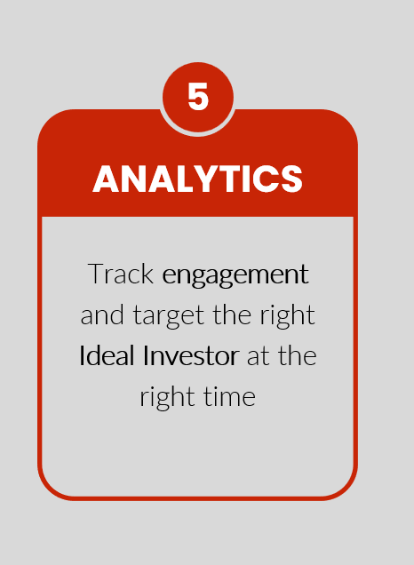
AGTM – Marketing Automation
Feed the Funnel
INVESTMENT

Slide 8
Template Design Masterclass
Do or Don’t – There Is No Try
1
Time-saving hacks
01
2
02
Brand vs. Content. How to strike a balance?
3
Effectively communicate your values
03
4
04
Creative design

Slide 9
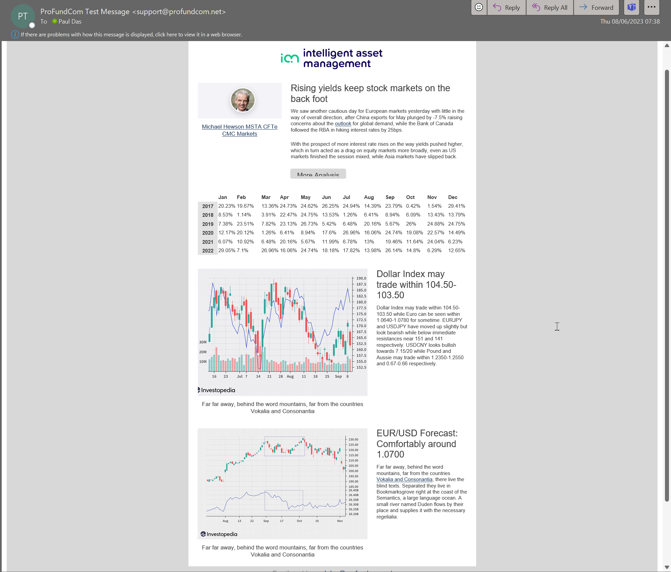



Automatically Build Templates
Template Automation

Slide 10
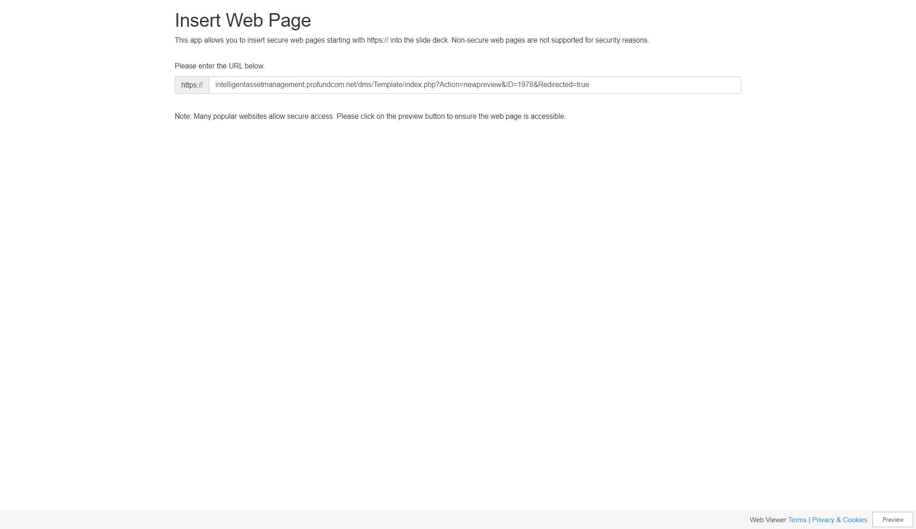
Content Analysis
Get a holistic view of delivery

Slide 11
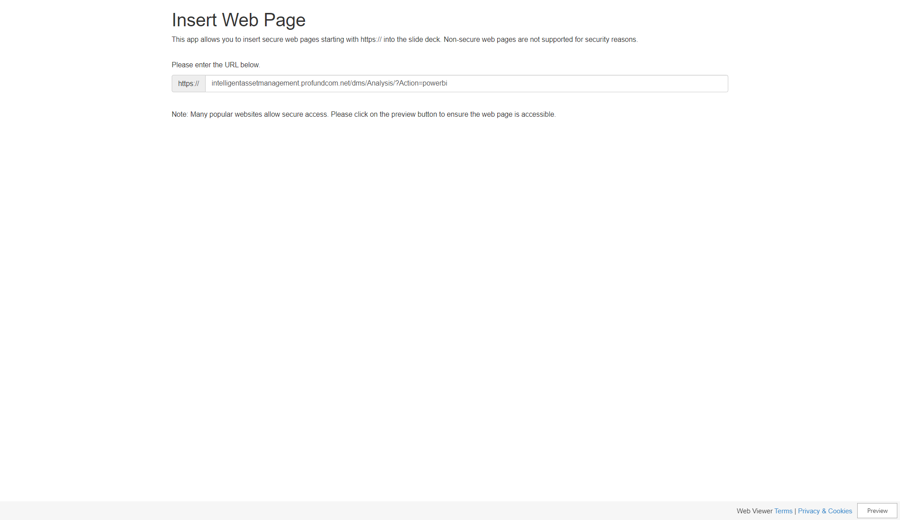
Data Visualisation
Track and Trace Trends

Slide 12

Automated Automations
Small Gains with Big Impacts

Slide 13
Time-saving hacks
Do or Don’t – There Is No Try
1
01
Keep in mind – Be respectful of other people’s time.
2
02
Put pen to paper & plan out the user journey – what content & platforms will they interact with. Work backwards from end point (landing page, article etc) to start point (your email).
3
03
Create consistency in your content, imagery & styling.
4
Build a master template that contains blocks for all your scenarios: news, event, fund update, webinar, awards. Then replicate your template and take out the parts you don’t need. This ensures you keep consistency within the template.
04

Slide 14
Template Design Masterclass
Do or Don’t – There Is No Try
1
Time-saving hacks
01
2
02
Brand vs. Content. How to strike a balance?
3
Effectively communicate your values
03
4
04
Creative design

Slide 15
Template Design Masterclass
Do or Don’t – There Is No Try
1
Time-saving hacks
01
2
02
Brand vs. Content. How to strike a balance?
3
Effectively communicate your values
03
4
04
Creative design

Slide 16
Brand vs. Content. How to strike a balance?
Do or Don’t – There Is No Try
1
01
Understand Your Audience: Start by understanding your target audience.
Define Your Brand Identity: Clearly define your brand identity, including colours, fonts, logos, and tone of voice to ensure consistency.
Content Relevance: Ensure that the content of your emails is tailored to the right audience, using industry-specific language and messaging.
Personalisation: Use personalisation strategies to make emails more relevant to individual recipients while maintaining brand consistency.
A/B Testing: Continuously A/B test different templates and messaging to find the right balance between brand elements and content for optimal engagement.
2
02
3
03
4
04
5
05

Slide 17
Template Design Masterclass
Do or Don’t – There Is No Try
1
Time-saving hacks
01
2
02
Brand vs. Content. How to strike a balance?
3
Effectively communicate your values
03
4
04
Creative design

Slide 18
Template Design Masterclass
Do or Don’t – There Is No Try
1
Time-saving hacks
01
2
02
Brand vs. Content. How to strike a balance?
3
Effectively communicate your values
03
4
04
Creative design

Slide 19
Effectively communicate your values
Do or Don’t – There Is No Try
1
Find your Voice: Specific to the company and its values. It will evolve over time, but your voice is what makes you stand out. There’s always a market for ‘different’ and ‘better’ and your voice can make you both.
Define Core Values: Clearly articulate your organisation's core values and mission.
Align your content with your audience’s needs. Doing so often speeds up subscriber growth.
Great Content: The best way to get new readers is by producing great content and telling great stories.
Showcase Success Stories: Highlight case studies, examples, or success stories that demonstrate how your organization's values have led to positive outcomes.
Educational Content: Offer content that showcases your expertise and commitment to addressing the financial needs of your clients.
01
2
02
3
03
4
04
5
05
6
06

Slide 20
Template Design Masterclass
Do or Don’t – There Is No Try
1
Time-saving hacks
01
2
02
Brand vs. Content. How to strike a balance?
3
Effectively communicate your values
03
4
04
Creative design

Slide 21
Template Design Masterclass
Do or Don’t – There Is No Try
1
Time-saving hacks
01
2
02
Brand vs. Content. How to strike a balance?
3
Effectively communicate your values
03
4
04
Creative design

Slide 22
Creative design
Do or Don’t – There Is No Try
The difference between a good newsletter and a great newsletter... is that the people who produce great newsletters are always trying to make their design better at catching readers’ attention, keeping them interested, and delivering value.

Slide 23
Creative design – Key components
Do or Don’t – There Is No Try
Create a great newsletter through the creative use of these key components:
• From Line: Contains your name & email address: Keep it personal and consistent.
• Subject Line: A chance to hook readers. What’s in it for them?
Start a story that the reader needs to know the ending to.

Slide 24
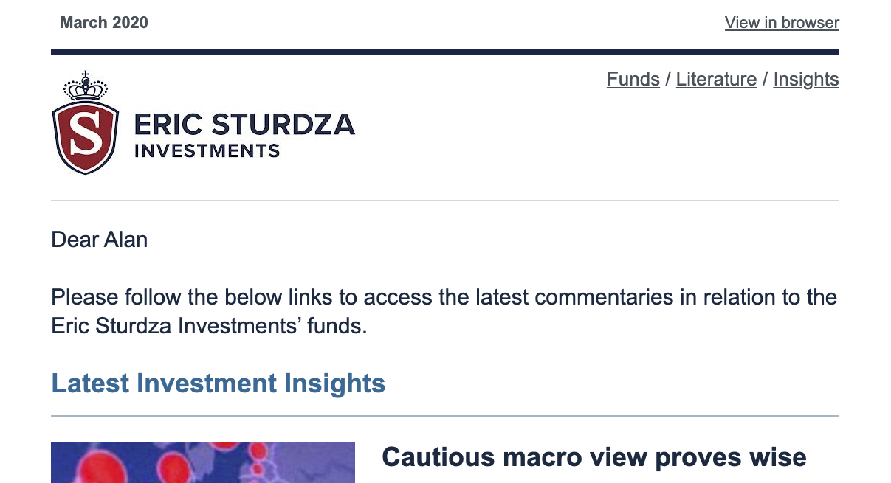


Creative design – Key components
Do or Don’t – There Is No Try
• The ‘Header’: Designed to draw readers in and may also be the only thing people see.

Slide 25
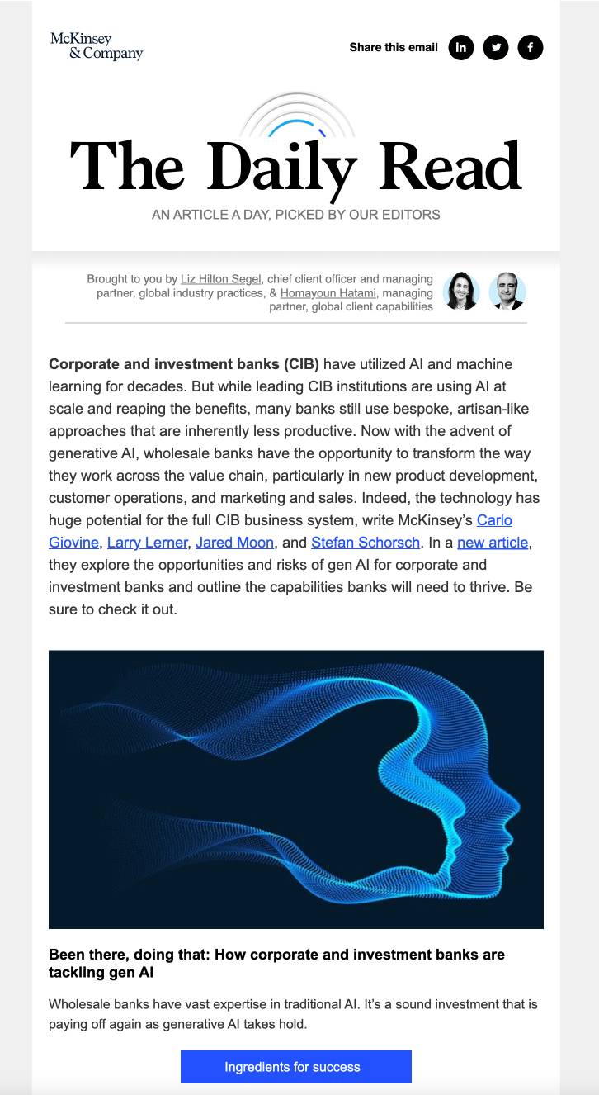
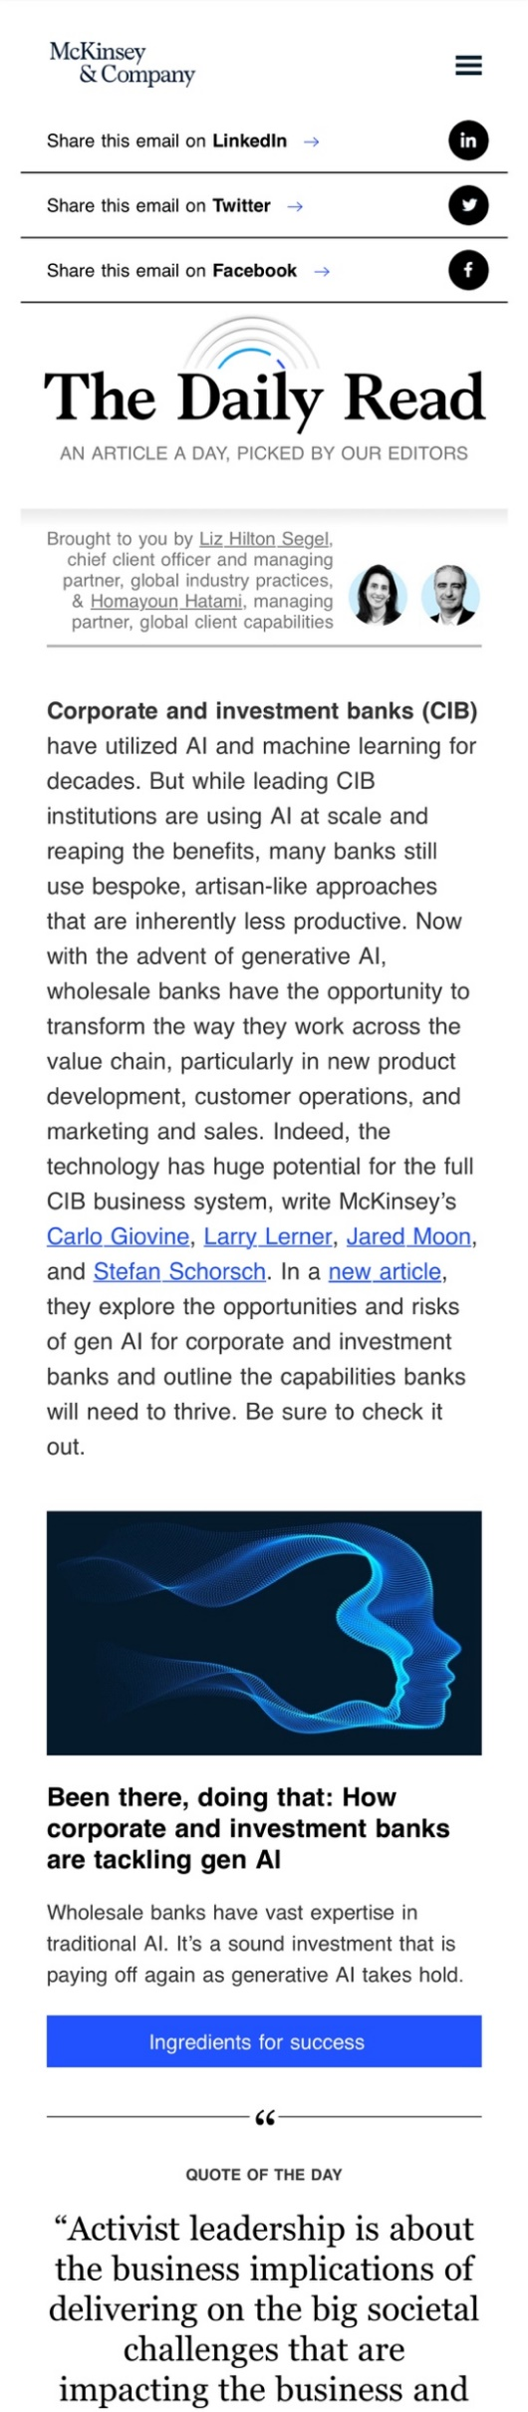
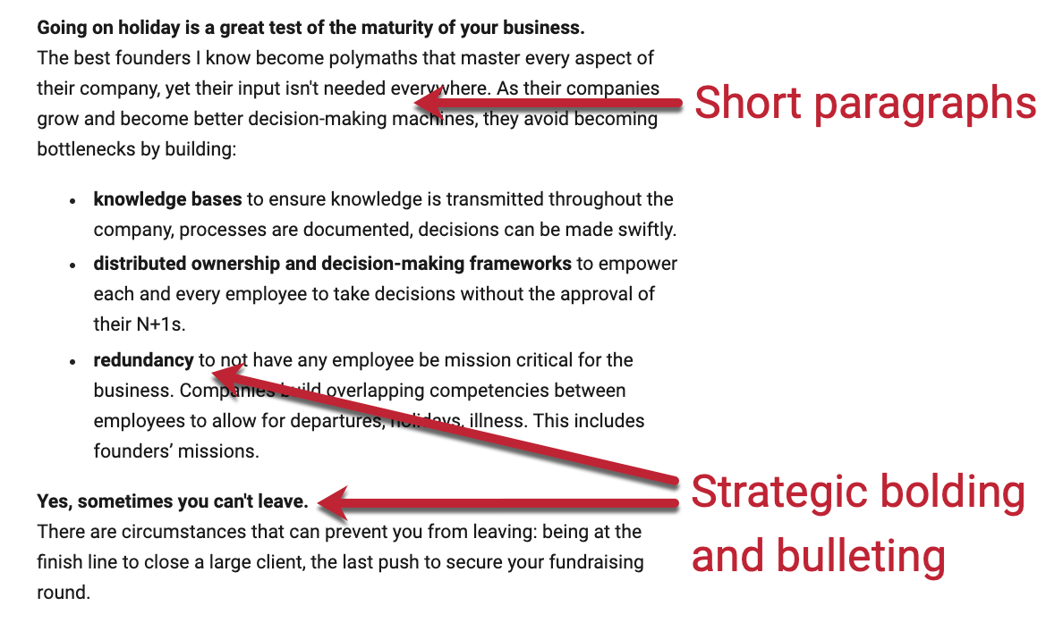
Creative design – Key components
Do or Don’t – There Is No Try
• Body Copy: Make it easy to read and
flow well. Short sentences and paragraphs, strategic bolding and bulleting and a good use of tone to keep people moving.
• Remember Mobile Readers: Test out how the content looks on mobile and refine.

Slide 26
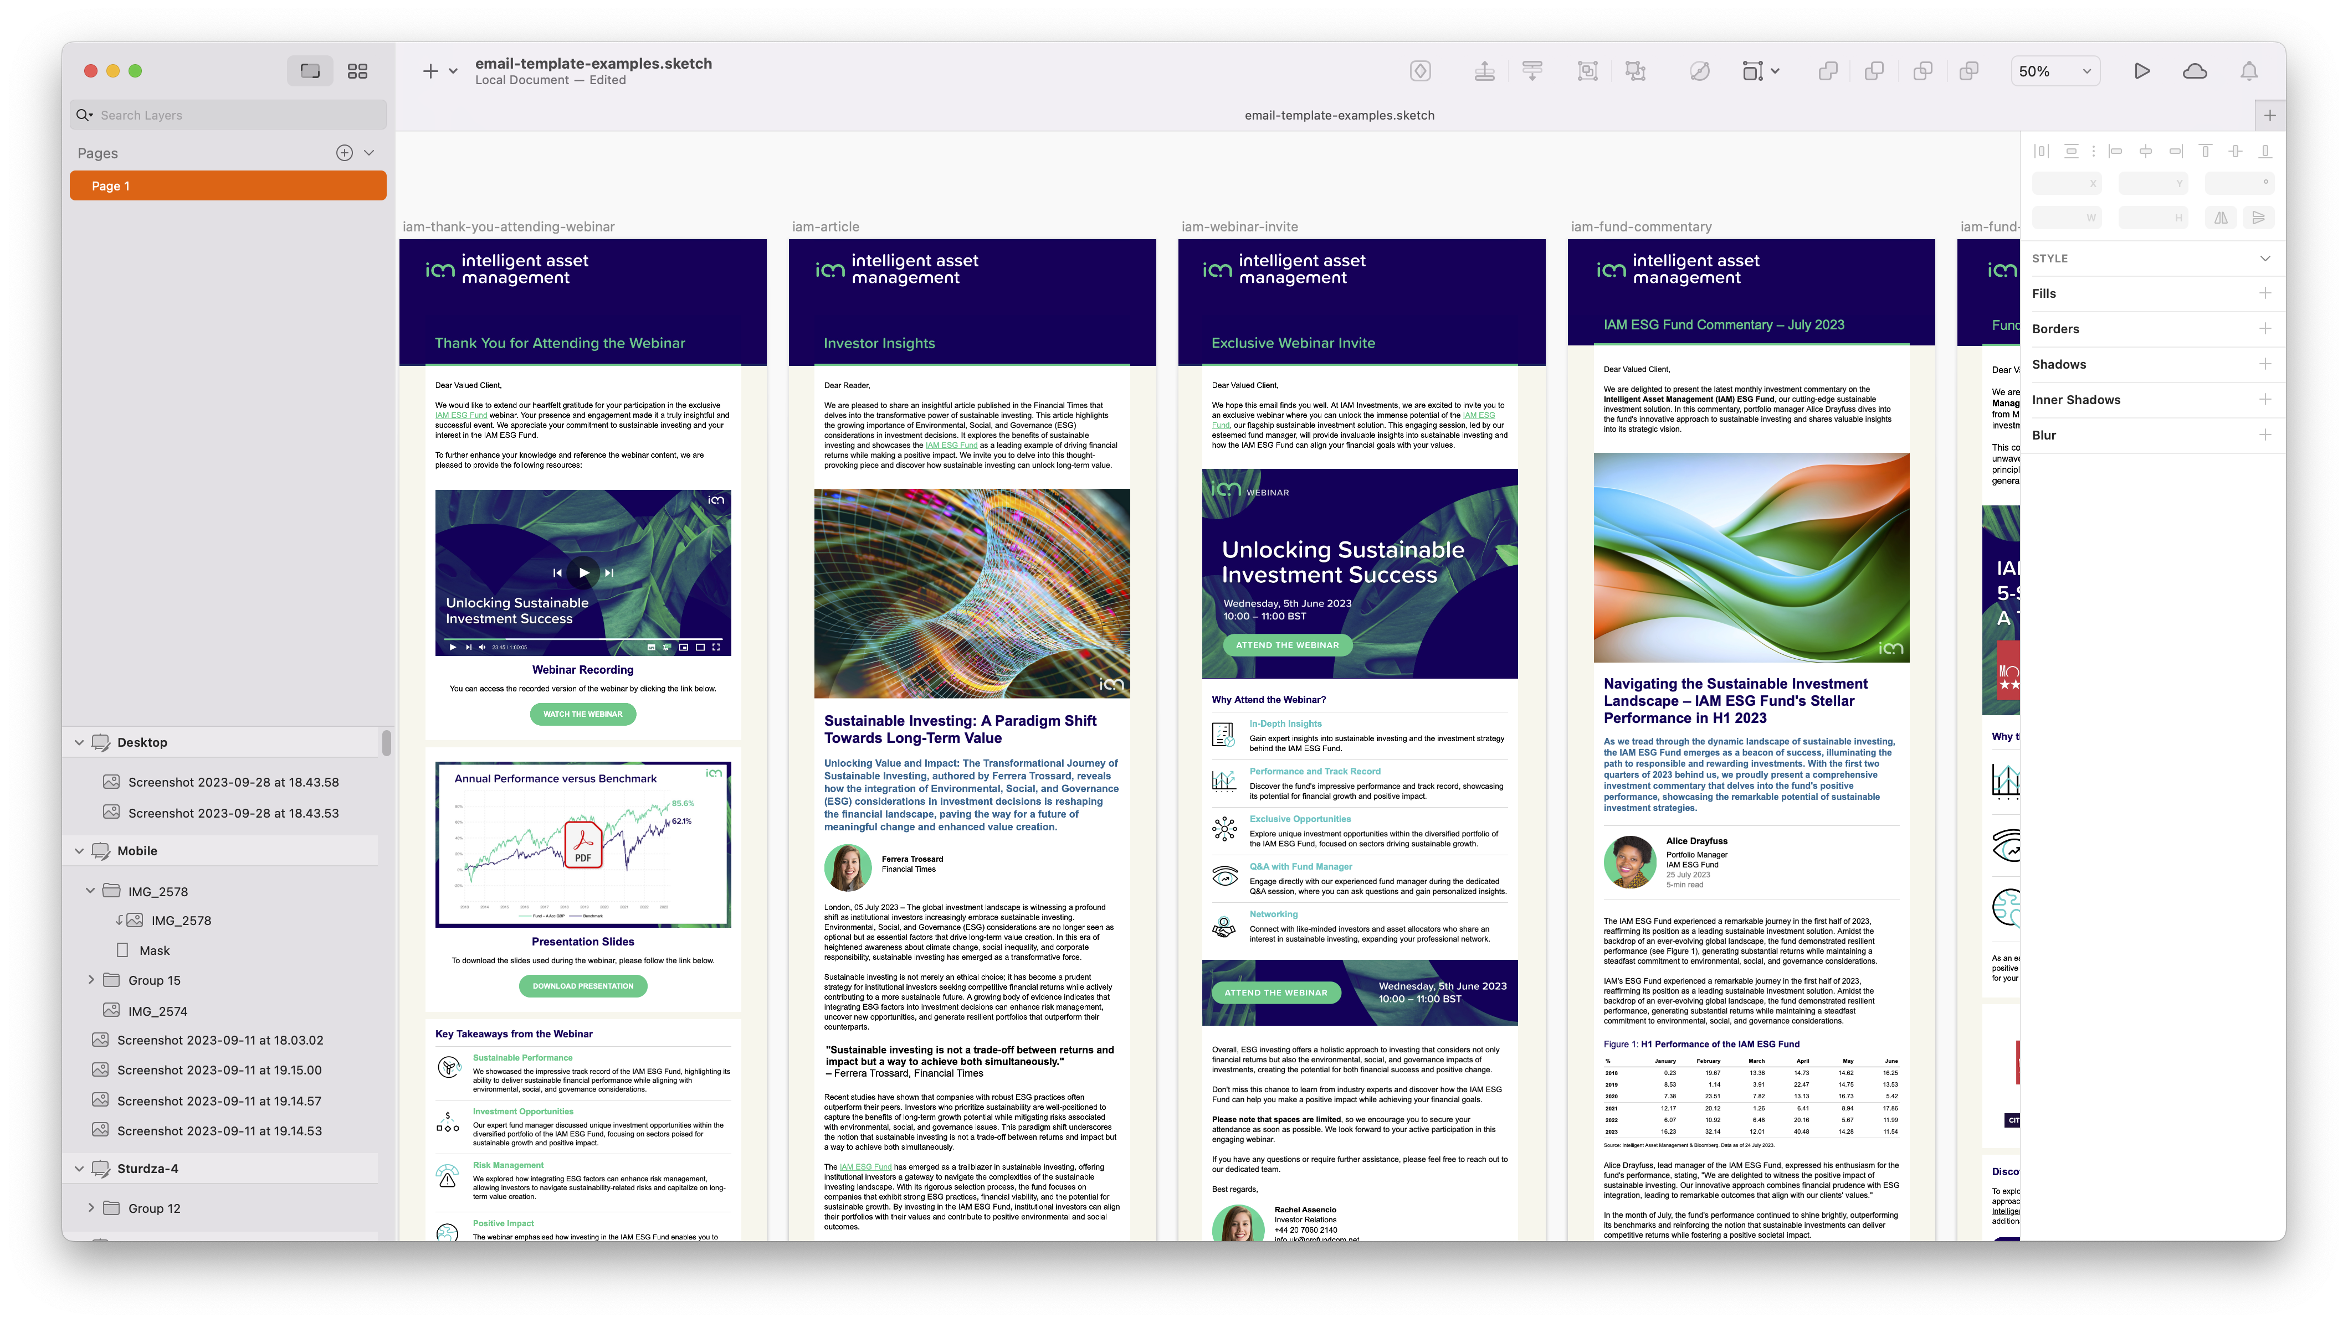
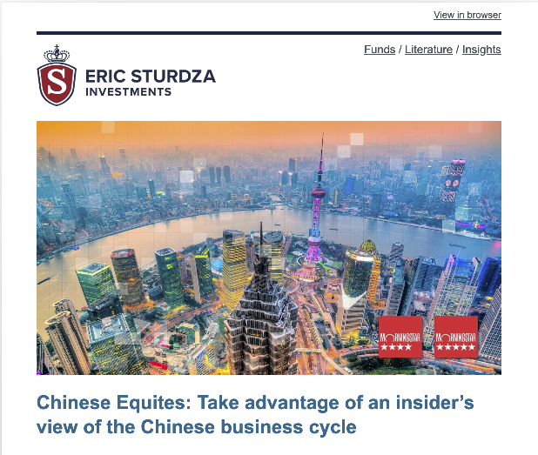

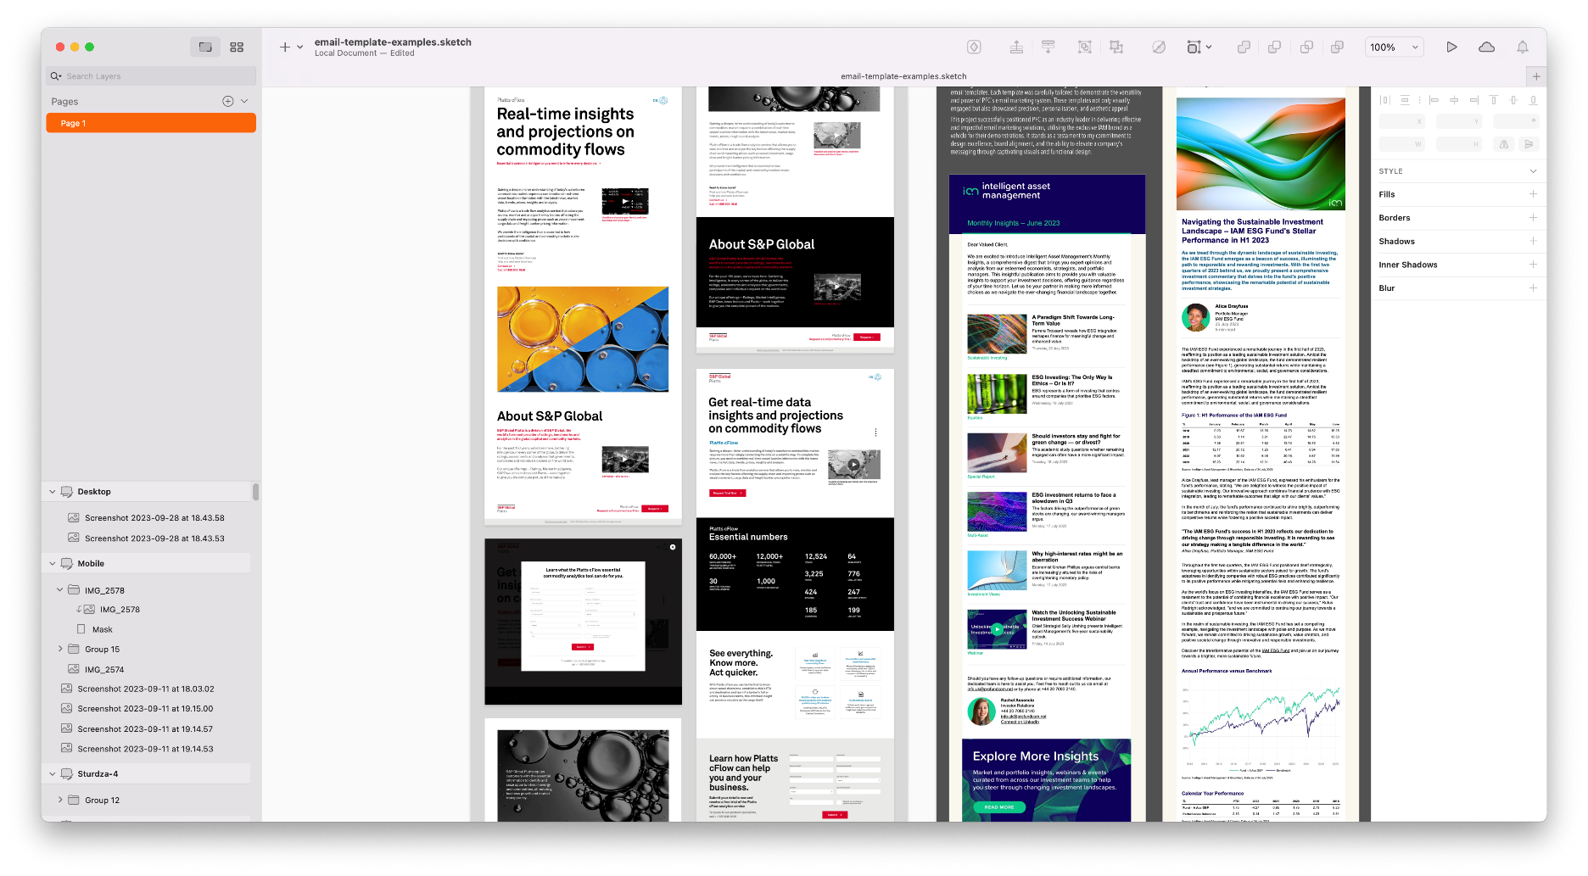
Creative design – Key components
Do or Don’t – There Is No Try
• Use of Images have many benefits:
1. Grab attention.
2. Break up text making it easier to consume.
3. Inspire people to share.
4. Images are part of your voice –
maintain consistency in visual style.

Slide 27
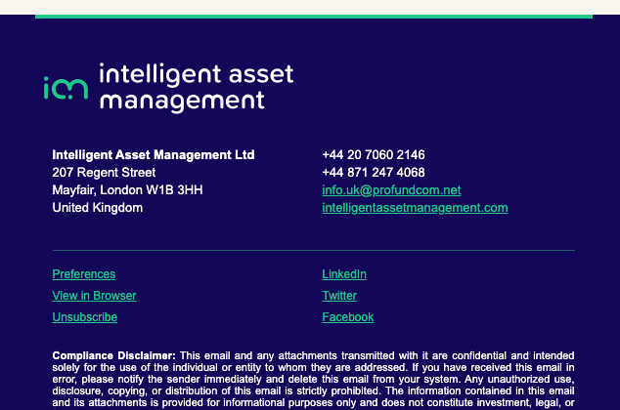
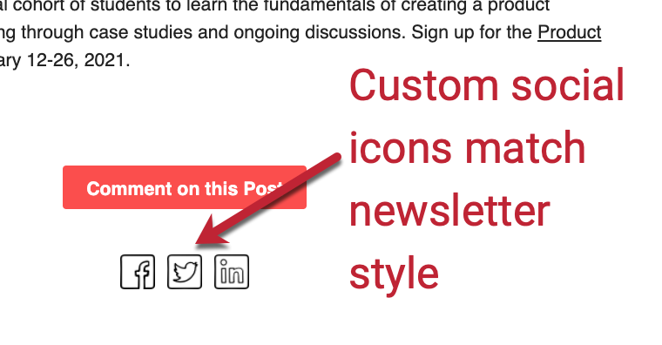

Creative design – Key components
Do or Don’t – There Is No Try
• Social Sharing Links: Make it easy for people to circulate your stories online. Include the platforms you know your target readers are active on. Customise the icons to align with your visual identity.

Slide 28
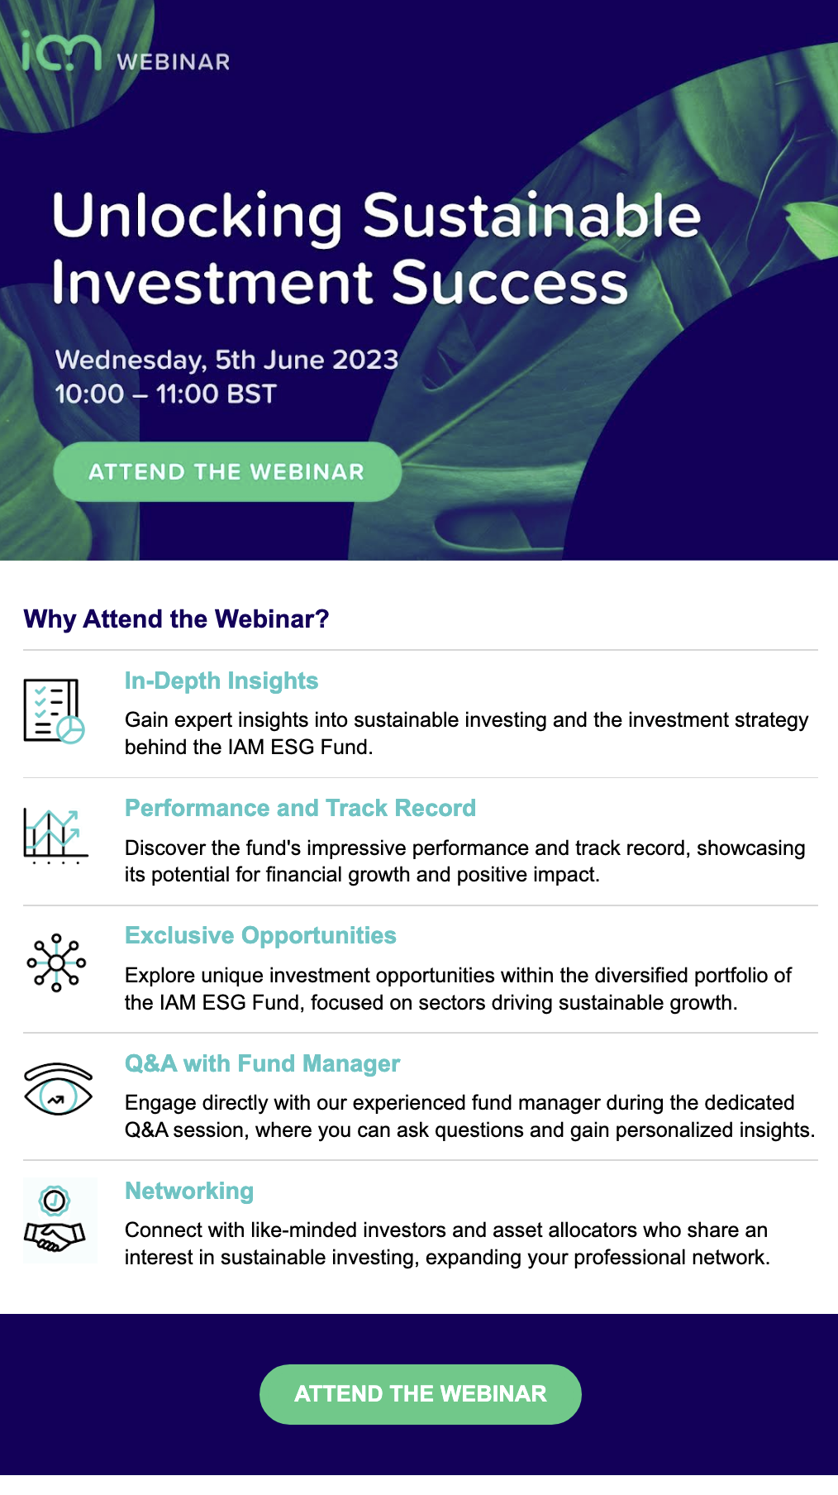
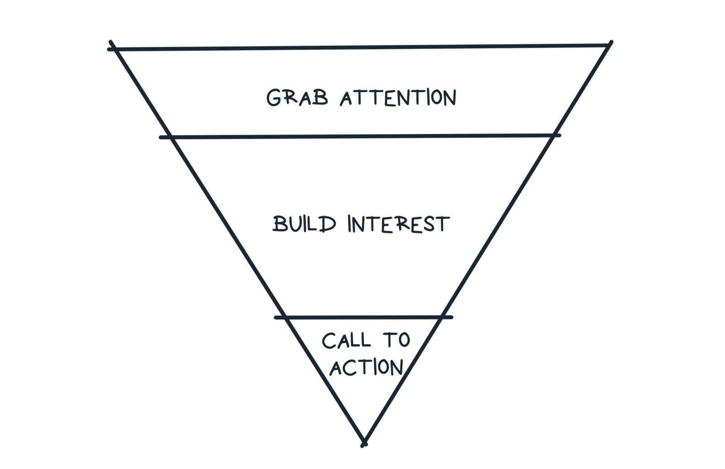
Creative design – Key components
Do or Don’t – There Is No Try
• Calls-to-Action: Link only to the things that are most important and benefit your readers. If something’s super important, link to it several times in different segments of the newsletter.
A concept for making great CTAs is called the inverted pyramid.
When you want someone to click on something, structure the content as an inverted pyramid, grabbing their attention with a big idea up top, building their interest, and calling them to act.

Slide 29
Creative design – Final Checks
Do or Don’t – There Is No Try
1
01
Testing and Quality Assurance: Test your templates across various devices
and email clients to ensure proper display and functionality
Data-Driven Improvements: Track and analyse email performance metrics such as open rates and click-through rates. Use data insights to refine your template designs and content for better results.
Finally, A consistent, well-designed template reinforces your brand's trustworthiness and fosters recognition. Over time, recipients associate your brand with professionalism and quality.
2
02

Slide 30
Template Design Masterclass
Do or Don’t – There Is No Try
1
Time-saving hacks
01
2
02
Brand vs. Content. How to strike a balance?
3
Effectively communicate your values
03
4
04
Creative design

Slide 31
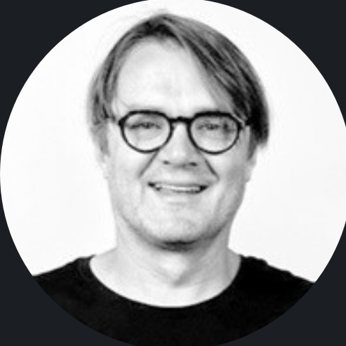
Need help with your templates?
Do or Don’t – There Is No Try
Thank you for listening. Feel free to reach out for any assistance or enquiries regarding your email templates and creative services. I’m here to help!
Alan Pitchforth
Creative Services Director
alan@kamilian.com
+44 7399 770455
www.linkedin.com/in/alan-pitchforth/

